Slide 1
UNIT-2 Bayesian Classifier

Slide 2
The Naive Bayes classifier is a supervised learning algorithm used for solving classification problems.
It is based on Bayes’ Theorem, which calculates the probability of a certain event occurring based on prior knowledge.
The Naive Bayes algorithm assigns new data points to the most likely class by comparing probabilities.
“naive” Means strong assumption: all the features in the dataset are independent of each other.
This means that the presence of one feature does not affect the presence of another.

Slide 3
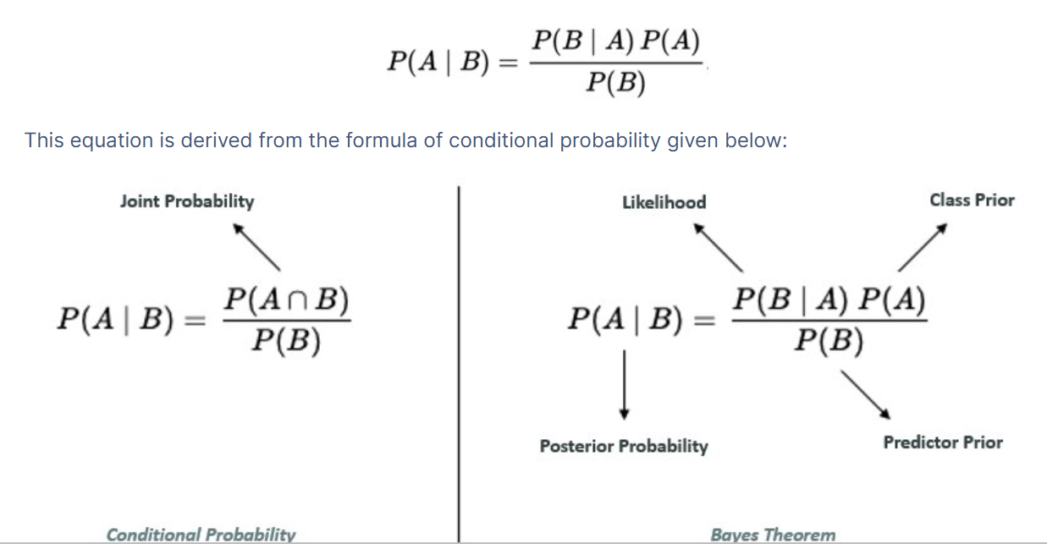
Bayes’ Theorem
It calculates the posterior probability of an event occurring based on prior knowledge and evidence.
i.E Bayes’ Theorem describes the probability of an event based on prior knowledge of the conditions that might be related to the event.
In simple terms, it helps answer: “Given some observations, how likely is this event to belong to a particular class?”
P(A∣B): Posterior probability – probability of hypothesis A given that B is true.
P(B∣A): Likelihood – probability of observing B given that A is true.
P(A): Prior probability – the initial probability of A before seeing any evidence.
P(B): Marginal probability of observing B.

Slide 4
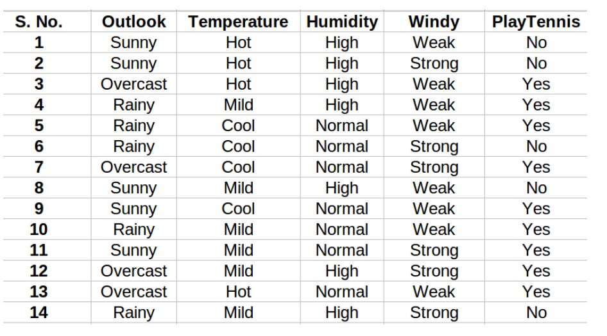
Dataset:
The goal is to predict whether it’s fit (“Yes”) or unfit (“No”) for playing golf based on the weather conditions.

Slide 5
How Bayes’ Theorem Works in Naive Bayes Classifier
In a Naive Bayes classifier, Bayes’ Theorem is used to calculate the probability of a class based on given features.
For instance, if we want to predict whether it is fit to play golf on a Sunny day with Mild temperature, the classifier will compute two probabilities:
P(Play = Yes | Sunny, Mild) – Probability of playing on a sunny, mild day.
P(Play = No | Sunny, Mild) – Probability of not playing on a sunny, mild day.
Whichever probability is higher becomes the final prediction.
Ex:

Slide 6
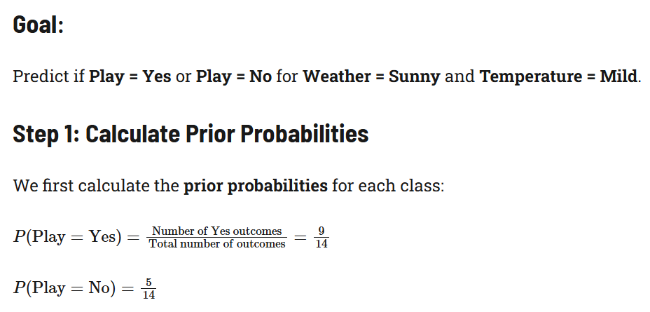
Step 1: Calculate the prior probability for given class labels
Step 2: Find Likelihood probability with each attribute for each class
Step 3: Put these value in Bayes Formula and calculate posterior probability.
Step 4: See which class has a higher probability, given the input belongs to the higher probability class.

Slide 7
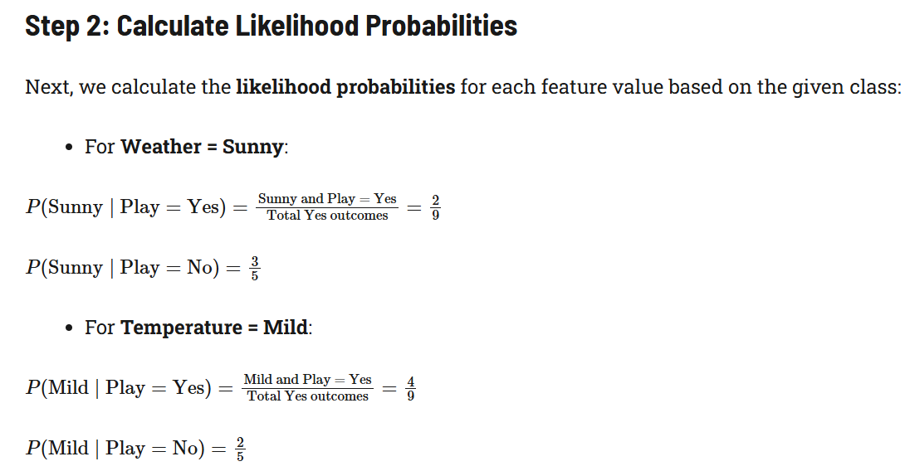
Or Conditional Probability

Slide 8
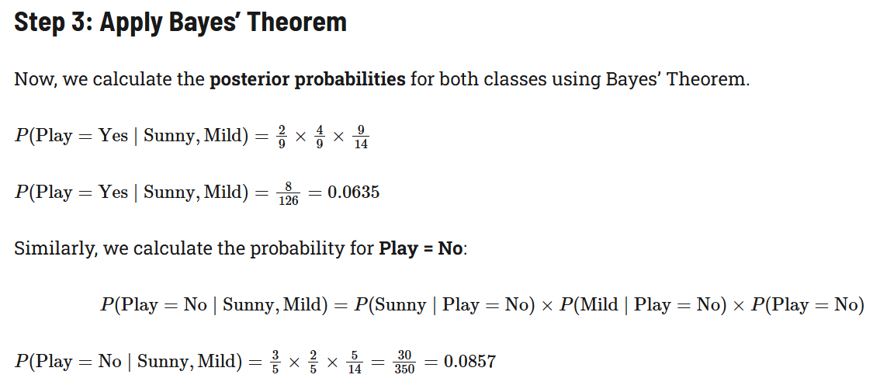
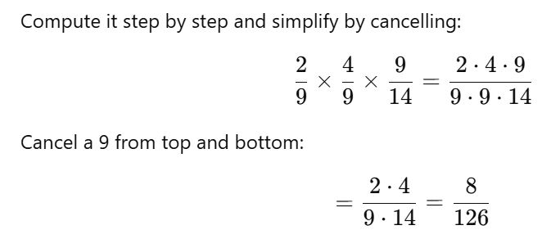

Slide 9
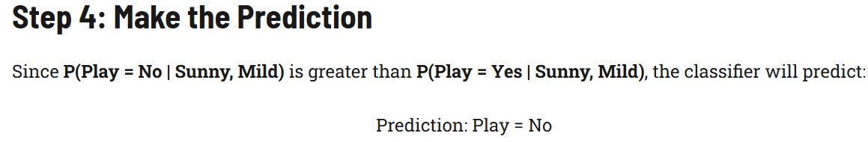
Read more using this link: https://www.datacamp.com/tutorial/naive-bayes-scikit-learn ( for more than one feature )

Slide 10
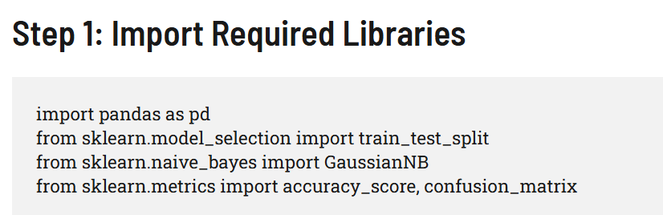
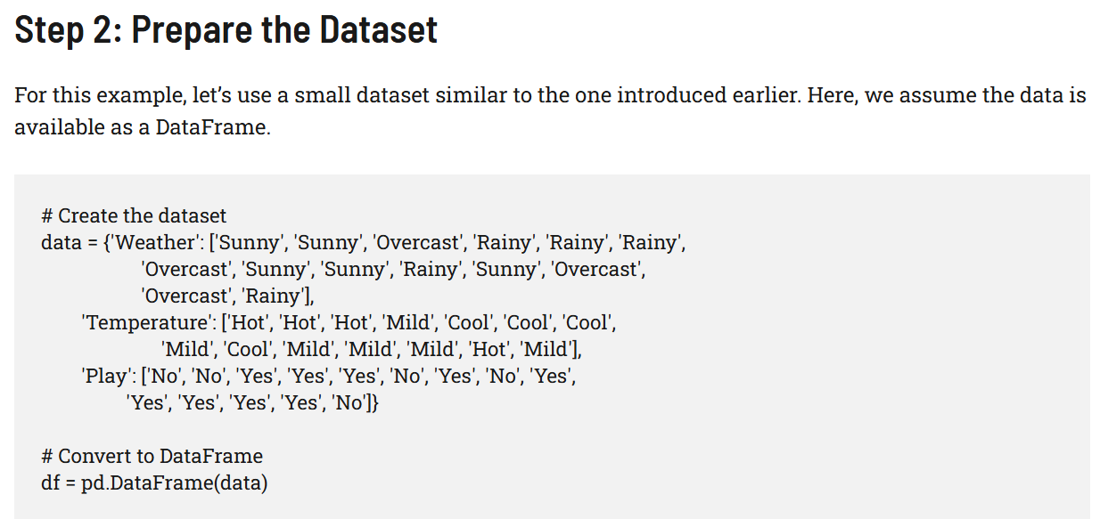

Slide 11
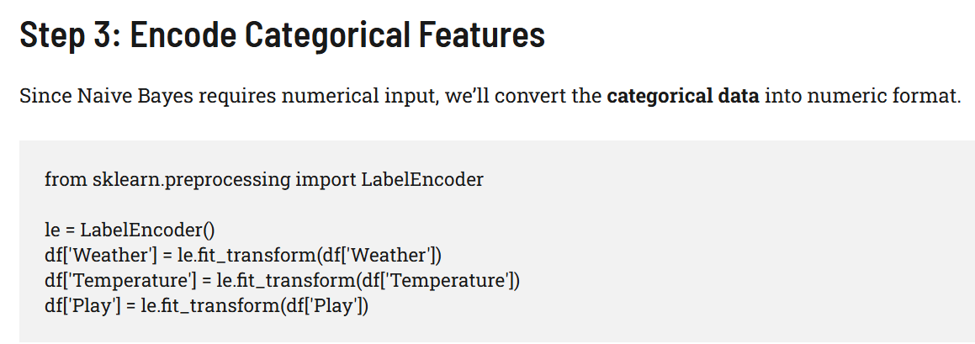

Slide 12
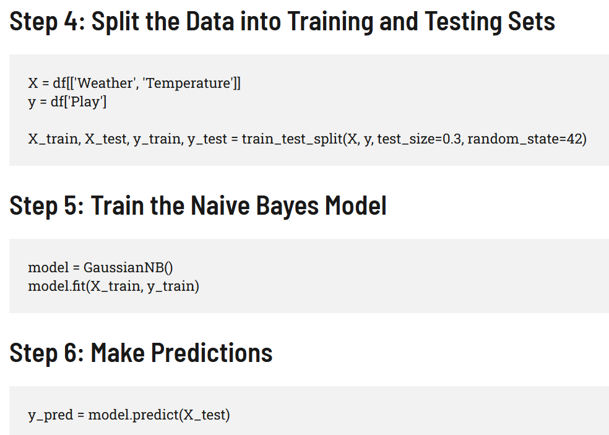

Slide 13
